Slide 1
Social Engineering
The Future of Social Engineering

Slide 2
Origin of “Social Engineering”
The term sociale ingenieurs was introduced in an essay by J.C. Van Marken, a Dutch Industrialist, in 1894.
Modern employers needed the assistance of social engineers in managing the human aspects of the industrial plant.

Slide 3
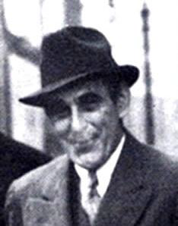
Social Engineering 100 years ago

Slide 4
Victor Lustig: A classic social engineer
Used current events (state of the economy)
Impersonated someone in authority
Made the deal an extremely attractive deal for buyers
Too good to be true
Sold the Eiffel Tower a number of times because victims were too embarrassed to go to the police

Slide 5
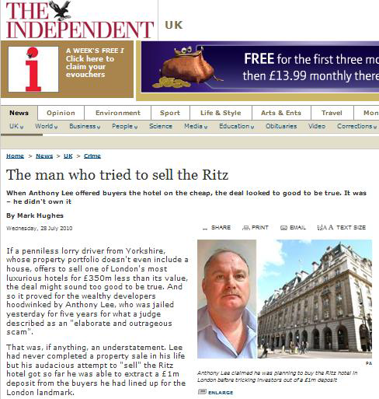
28 July 2010

Slide 6
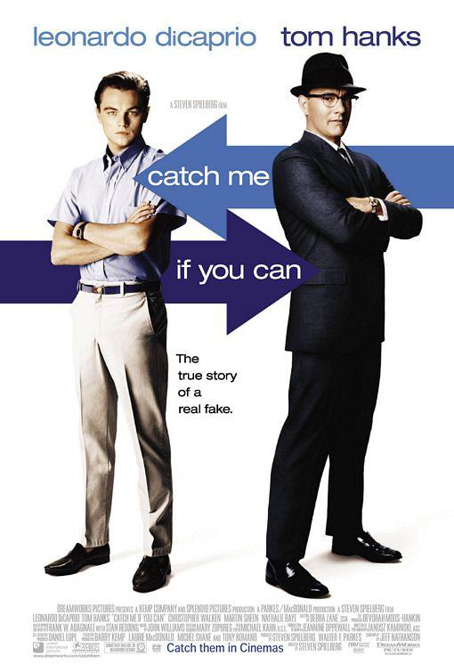
Impersonation (40 – 50 years ago)
This worked because:
Conveyed authority
Sufficient research performed
Acted and looked the part
Would it still work today?

Slide 7
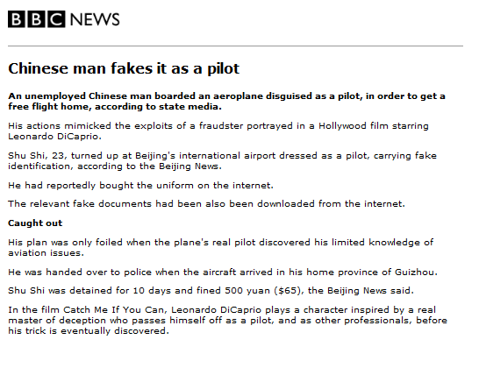
June 2007

Slide 8
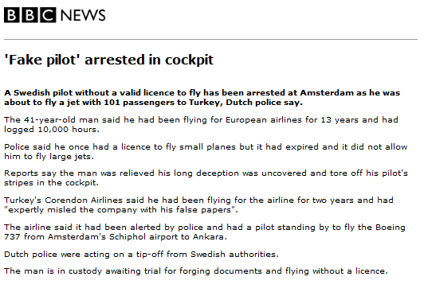
March 2010

Slide 9
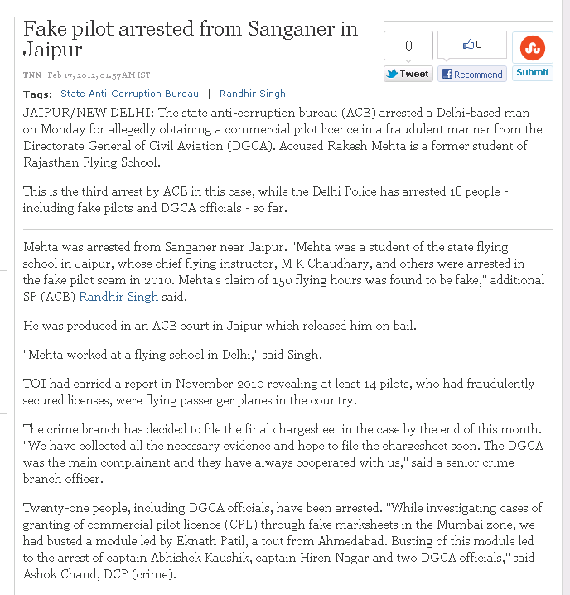
February 2012

Slide 10
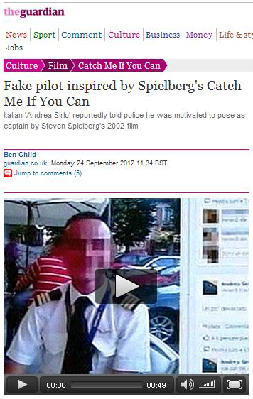
September 2012

Slide 11
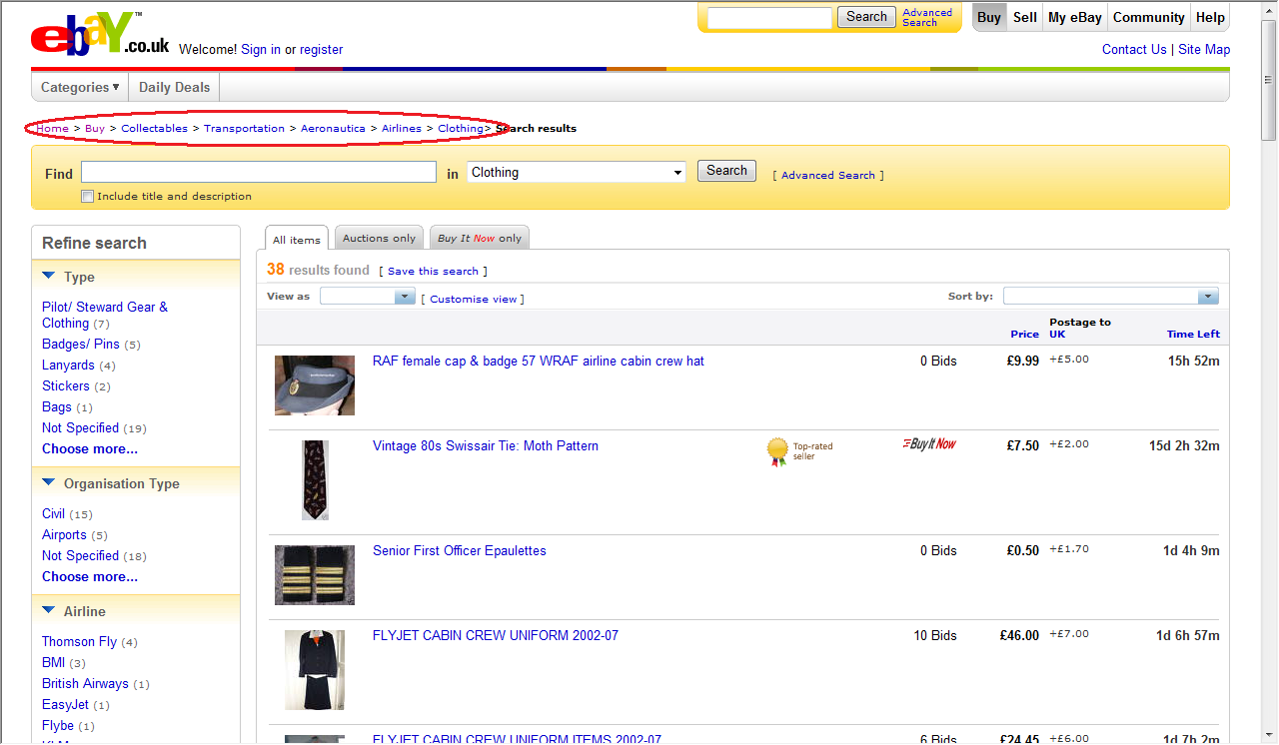
How did they do it?

Slide 12
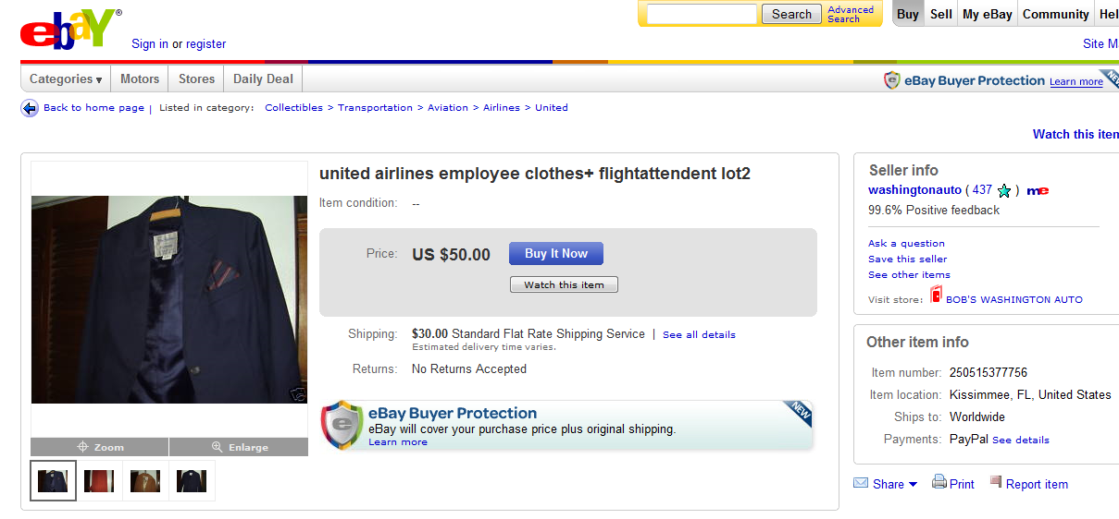
How did they do it?

Slide 13
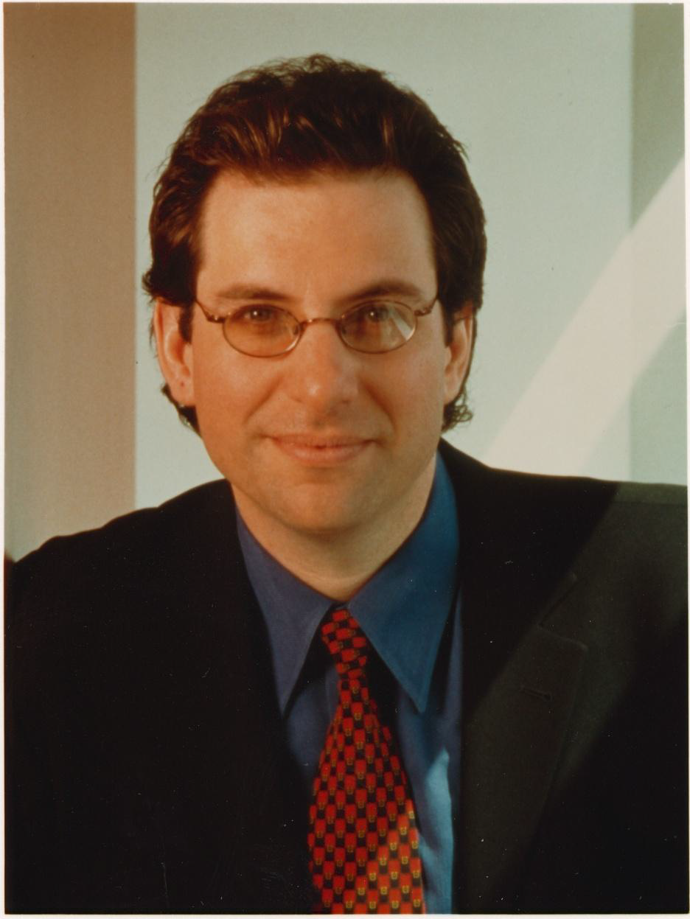
Social Engineering 20 years ago
Techniques hackers use to deceive a trusted computer user within a company into revealing sensitive information, or trick an unsuspecting mark into performing actions that create a security hole for them to slip through
- Kevin Mitnick

Slide 14
Social Engineering 10 years ago
Love Bug virus
First time we received malicious emails from people, so why not open them?
Simple script with clear, unobfuscated code
First phishing attacks
Started in the mid 1990’s when AOL brought in controls to prevent opening accounts using fake credit card numbers
Phishers impersonated AOL staff and sent instant messages to victims asking for their passwords
“verify your account”
“confirm billing information”

Slide 15
Recent Social Engineering Headlines
August 2012: Tech journalist, Mat Honan’s digital life erased as hackers social engineer Apple and Amazon call centers
May 2012: Czech thieves steal a 10-tonne bridge with forged documents to say they were working on a new bicycle path
January 2012: Paul Allen’s credit card details stolen by social engineering Citibank call centers
December 2011: Wells Fargo wire $2.1m to a bogus bank account in Hong Kong following a series of fraudulent faxes

Slide 16
The future of Social Engineering
Same tricks, new technology
More sophisticated and targeted SE attacks
Social networking as an enabler to SE
More technology to improve/automate SE attacks
Social engineering as a service

Slide 17
#1 Same tricks, new technology

Slide 18
Advance Fee Fraud
Nigerian posta/fax scams in the 80s
419 scam
Friend scam
Scams work because they evoke emotion or greed (recently coming from your friends)

Slide 19
Nigerians scams in the 80s
In the early 80’s, Nigeria’s oil-based economy declined.
Some unemployed university students original devised this scam to manipulate visitors to Nigeria interested in shady oil deals.
They went on to target businessmen, sending messages via postal letters, fax ...and eventually email.

Slide 20
419 Scam – Dec 2009
Greetings,
This message might meet you in utmost surprise; however, it is just my urgent need for foreign partner that made me to contact you for this transaction. I am a banker by profession from Burkina Faso in West Africa and currently holding the post of Director Auditing and Accounting unit of the bank. I have the opportunity of transferring the left over funds ($12.5million) of one of my bank clients who died along with his entire family on 31 July 2000 in a plane crash. You can confirm the geniuses of the deceased death by clicking on this web site http://news.bbc.co.uk/1/hi/world/europe/859479.stm hence; I am inviting you for a business deal where this money can be shared between us in the ratio of 60/38 while 2% will be mapped out for expenses. If you agree to my business proposal. Further details of the transfer will be forwarded to you as soon as i receive your return mail.
1.Your name..................
2.Your phone..................
3.Age........................
4.Sex.........................
5.Profession.................
6.Address....................
Best regards. Mr. Salam Ahmed

Slide 21
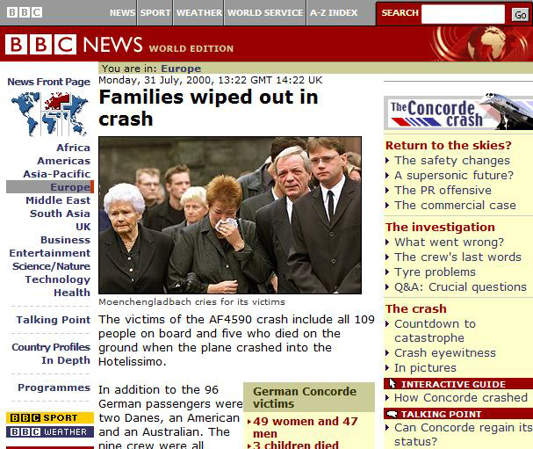
It is reported on BBC, this must be genuine

Slide 22
Friend Scam
How are you doing today? I am sorry i didn't inform you about my traveling to Nigeria for a program. It as been a very sad and bad moment for me over here and the present condition that i found myself is very hard for me to explain.
I am really stranded in Nigeria because I forgot my little bag in the Taxi where my money, passport, documents and other valuable things were kept on my way to the Hotel am staying, I am facing a hard time here because I have no money on me to clear my Hotel bill, I am now owning a sum $2,000 of my Hotel bill.
I need you to help me out with a sum of $3,500 urgently so that i can arrange and travel back home,I need this help so much and on time because i am in a terrible and tight situation here, understand how important and urgent i need your help.
I will appreciate what so ever you can afford to send me immediately through Western Union and I promise to pay back your money as soon as i return home.please use the below information to transfer me the money.
Name : XXXXXXXXX
Address : XXXXXXXXX
State : XXXXXXXXX
Country : XXXXXXXXX
Zip code: XXXXXXXXX
Question : please
Answer : Urgent
kindly get back to me with the scan copy of the transfer receipt so i will be able to go and pick up the money.
I will be waiting to hear from you soon.

Slide 23
Old attacks reworked on Social Networks
Instead of coming from a stranger in Nigeria attack comes from your friend
Instead of receiving an email you are contacted via a social networking site
Naturally, you want to help your friend

Slide 24
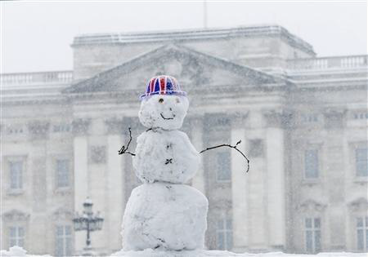
Friend Scams of the Future
I’m stranded in London because of the snow. All flights have been cancelled. Please could you lend me some money so I can buy a train ticket instead…?

Slide 25
#2 More sophisticated and targeted SE attacks

Slide 26
Targeted Phishing Attacks
Spear phishing = phishing attack aimed at a particular person
Whaling = phishing attack aimed at the rich and powerful
These attacks are often believable because they offer some information that is personal to the victim.

Slide 27
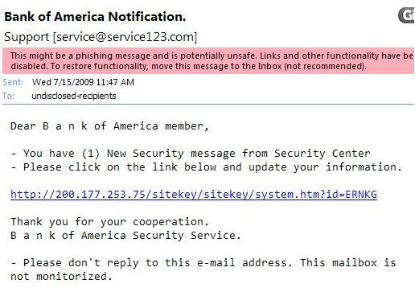
Bad Examples (but they still work)

Slide 28

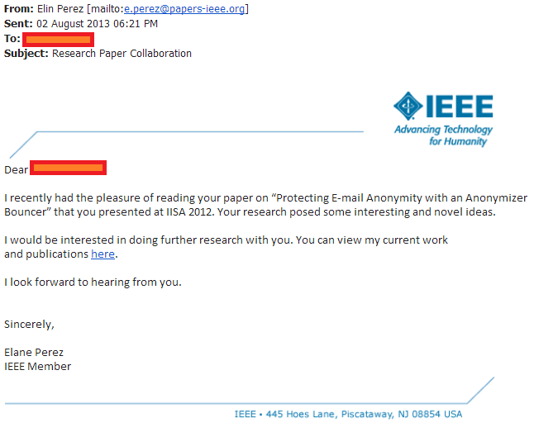
ISSA 2013

Slide 29
Bait will not always be online
People are less suspicious of “real world” bait
How would “real world” spear phishing work?
Traffic ticket incident

Slide 30
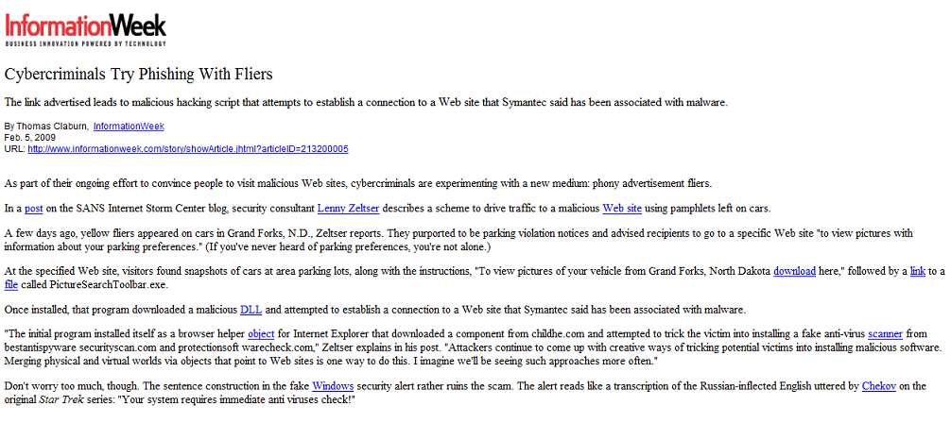

Slide 31
#3 Social networking as an enabler to social engineering

Slide 32
Why social engineers use social networking
HUGE attack surface
Quick and easy, even automated
E.g. Set up a botnet to gather email addresses for phishing or phone numbers for vishing/smishing
Low barrier entry point
Relies on publicly available information (no wrongdoing)

Slide 33
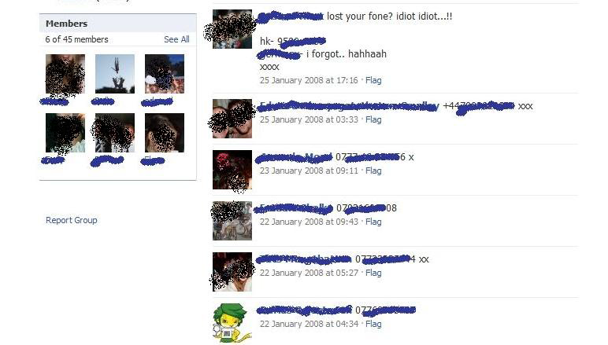
Gathering phone numbers has never been easier

Slide 34
Why Social Engineering over Social Networking works
Trust model
No real authentication
Easy to impersonate someone else or set up a fake profile
Influential
Social proof: people do things that other people are doing
Similarity: people are influenced by people they like
Hey, look at this. John says it’s cool.

Slide 35
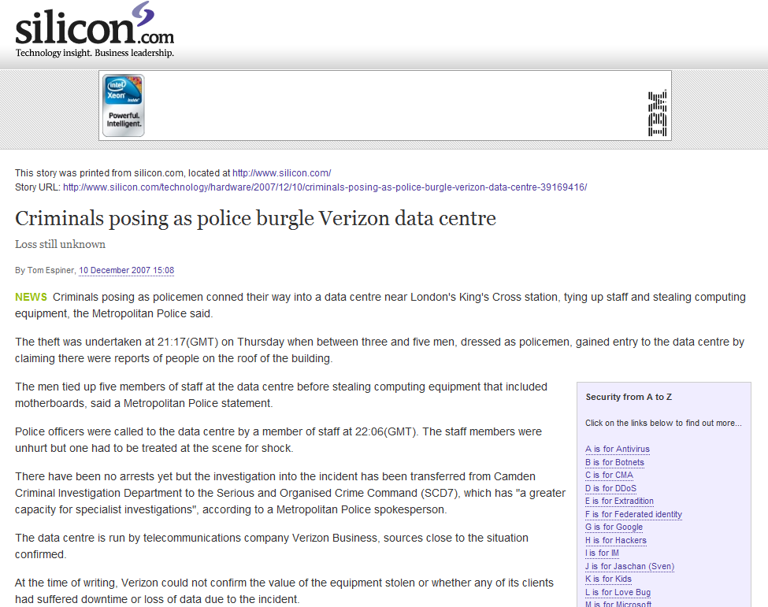
Impersonation in the Real World

Slide 36
#4 More technology to improve/automate social engineering attacks

Slide 37
Software for SE
Reconnaissance tools like Maltego
Metasploit for fake documents
The Social Engineers Toolkit (SET) one stop social engineering shop
Photoshop / GIMP to fake ID cards or documents
SpoofCard / SpoofApp for spoofing phone numbers

Slide 38


Slide 39
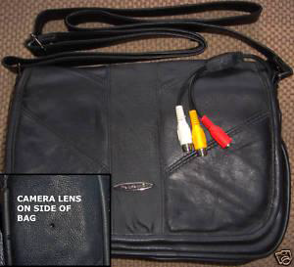

Slide 40
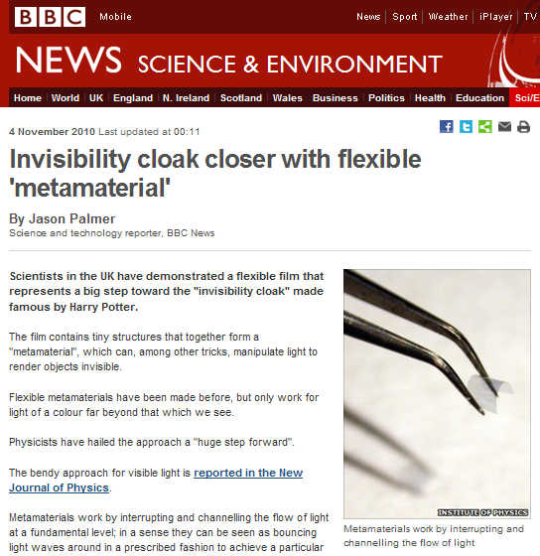

Slide 41
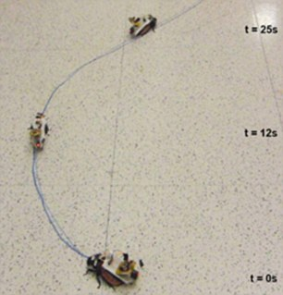
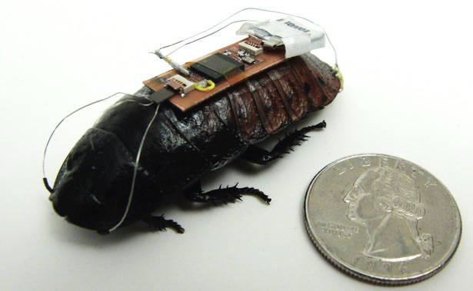
Cockroach Spies

Slide 42
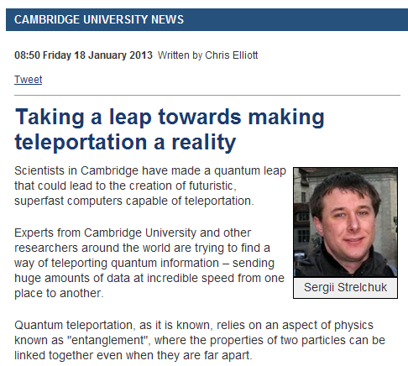

Slide 43
#5 Social Engineering as a Service

Slide 44
Social Engineering as a Service
It it’s still too much work, outsource it!
SE telephone services offer:
professional callers (male and female) fluent in numerous languages
caller-ID spoofing
available to make calls during business hours across the world
Cost: $7-15 per call

Slide 45
Example
Fraudster buys the credit card information of a 77-year old Italian woman from an underground forum.
The fraudster wants to purchase expensive goods online (e.g. Laptops) to resell for cash.
A credit card can cost as little as $2. A laptop might sell for $500. Big profit!
To make the purchase, the fraudster must change the credit card’s billing/delivery address. So he needs to call the card issuer.
BUT he doesn’t sound like a 77-year old Italian woman.

Slide 46
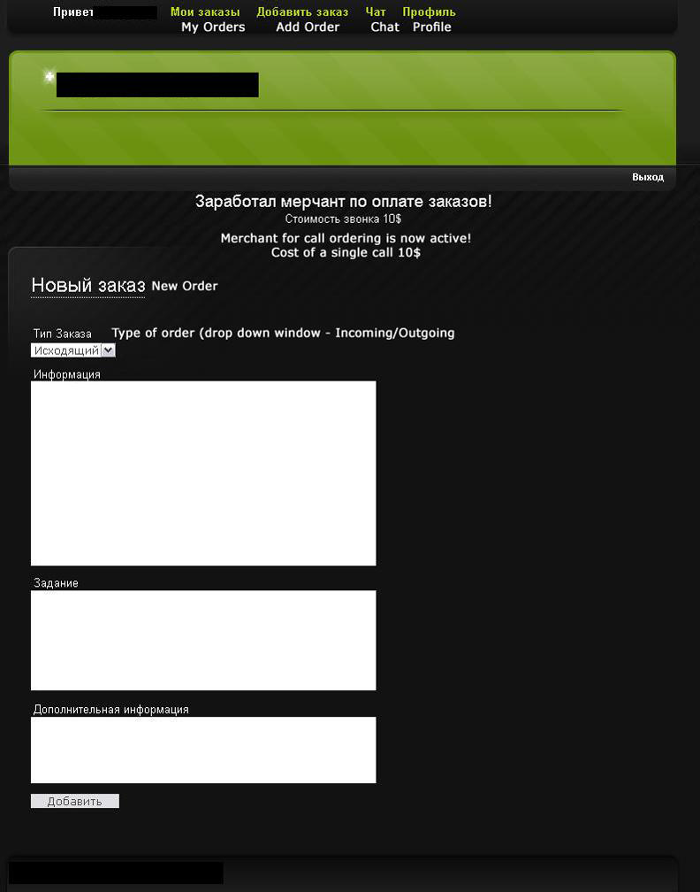

Slide 47
Professional Call Service
Calling: Shops, Drops, Casinos, Banks, Hosting Companies, UPS, FedEX
9 english speaking males. 3 females
Italian: Male (15 WMZ, Calling time etc. May be discussed)
German: Only Female
Spoofing numbers to any number (USA)
Can accept incoming calls on mine or your number.
Can fix up a custom number by state.
Working hours – Mon-Fri. Sat. 18:00-02:00 Moscow Time.
(99% of days I am online until 04:00)
Prices:
Any call 12$
Incoming call 12$
Creating a number:
10$. Time To Live: 1 Week min, probably longer. Almost all area codes.
We accept money only for “full” calls: called the right location, talked with the person we needed to. We don’t charge you for answering machines. No additional charge to leave a message. If an operation fails (example: failure in a balance transfer) because of insufficient data provided by customer we hold no responsibility (example: question about cardholder’s neighbors, as we didn’t have this info) and other reasons.
Its possible to arrange a drop-project phone support.
Returning customers are allowed to delay payment, discounts, etc.
Contact ICQ

Slide 48
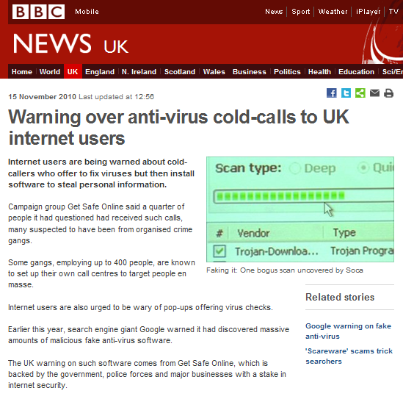

Slide 49
The future of Social Engineering
Same tricks, new technology
More sophisticated and targeted SE attacks
Social networking as an enabler to SE
More technology to improve/automate SE attacks
Social engineering as a service

Slide 50
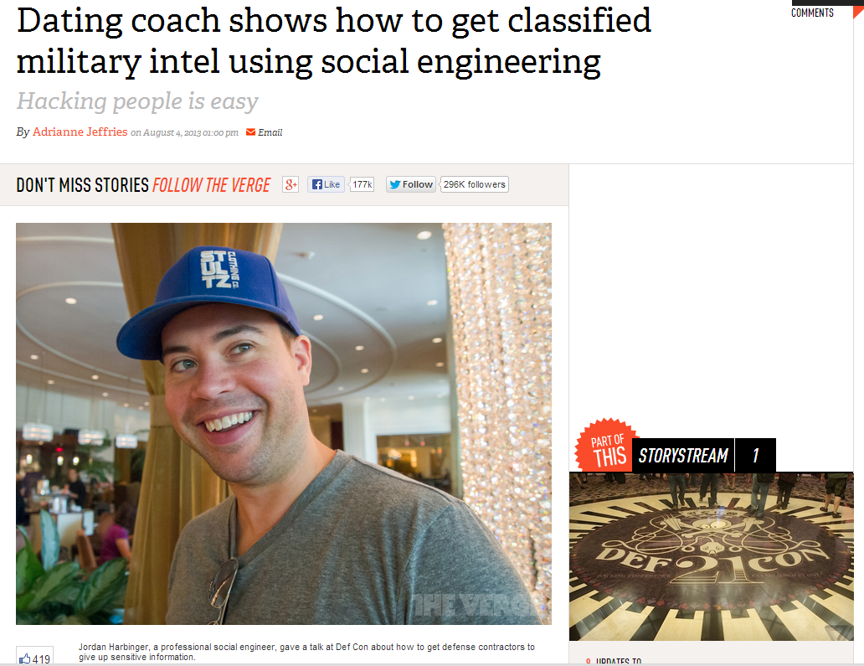
#6 More social engineering testing

